Slide 1
Computer Representation of Venn and Euler Diagrams
Diunuge B. Wijesinghe, Surangika Ranathunga, Gihan Dias
Department of Computer Science and Engineering, University of Moratuwa, Sri Lanka
{diunuge.10, surangika, gihan}@cse.mrt.ac.lk

Slide 2
Introduction
Diagrams are a very important communication medium
Mathematical diagram understanding is a complex challenge
Diagram understanding is an important pre-requisite of various fields such as image database systems, and educational diagram grading systems
There is no significant research done to interpret Venn and Euler diagrams
We address the problem of computer understanding of Venn and Euler diagrams that are available in vector format

Slide 3
Motivation
Venn & Euler diagrams are a significant part of mathematics
Especially in exams of secondary education such as London Ordinary Level and SAT Mathematics
In the automatic assessment facilities for mathematics require automatic or semi- automatic diagram assessment method
For the diagram assessment diagram interpretation method is required
For Venn & Euler diagrams, interpretation method is not developed

Slide 4
Previous Work
Futrelle et al [1] presented a diagram understanding system to interpret diagrams based on constraint grammars. The system is capable of handling x-y graphs and gene diagrams in Biological domain [2].
Thomas et al [3, 4, and 5] developed a computer aided assessment system that can handle graph based diagrams such as Entity-Relationship diagrams and flow charts
Huang et al [6, 7] developed a system that can understand chart images.
Burton et al [8] introduced a abstract syntax for Euler diagram representation

Slide 5
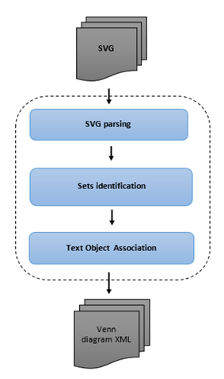
Venn & Euler Diagram Parser
System accept SVG vector images as the input diagrams
SVG diagram is parsed & Extract the domain related information
Interpreted diagram is given as XML output

Slide 6
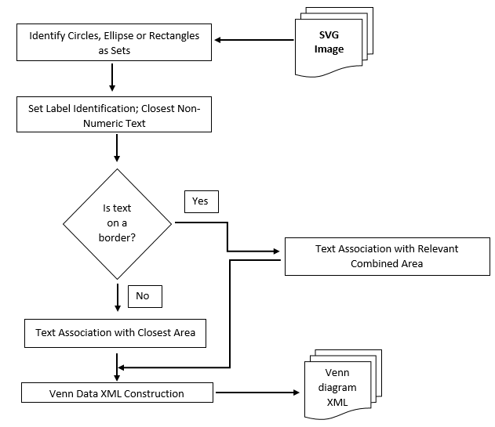
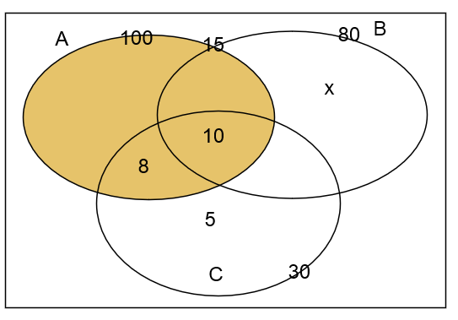
Venn & Euler Diagram Parser Contd.
Close distance parameters are tuned with reference to minimal font size of a image
Text-area association are depend of the centroid, size of the area and the text location

Slide 7
Diagram Representation
Abstract Syntax
Labels = {A, B, C}
Curves = {c_{a}, c_{b}, c_{c}}
Regions(Called Zones) = {{~c_{a}.~c_{b}.~c_{c}}, {~c_{a}.~c_{b}.c_{c}}, {~c_{a}.c_{b}.~c_{c}}, {~c_{a}.c_{b}.c_{c}}, {c_{a}.~c_{b}.~c_{c}}, {c_{a}.~c_{b}.c_{c}}, {c_{a}.c_{b}.~c_{c}}, {c_{a}.c_{b}.c_{c}}}
No of elements = {{c_{a}=100}, {c_{b}=80}, {c_{c}=30}, {c_{a}.c_{b}=15}, {~c_{a}.~c_{b}.c_{c} =5}, {~c_{a}.c_{b}.~c_{c}=x}, {c_{a}.~c_{b}.c_{c}=8}, {c_{a}.c_{b}.c_{c}=10}}
Shaded Zones ={c_{a}}
Venn Diagram in SVG file format

Slide 8
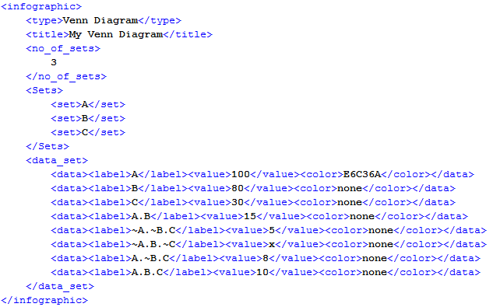
Diagram Representation Contd.
Venn Diagram in SVG file format
Venn Diagram after parsing

Slide 9
Evaluation
Venn parser is tested and tuned using the Venn diagrams gathered from university undergraduates, which are drawn directly using an SVG editor
For the evaluation, collected hand-written answer scripts that collectively contained 3 Venn and 4 Euler diagrams from university undergraduates and grade 10 school students.
Collected 77 diagrams are converted to SVG using a editor & given to the parser
Parser results are validated for each diagram manually

Slide 10
Results
Diagram No. | Diagram Type | Correctly Parsed | Incorrectly Parsed | Accuracy
1 | Venn | 17 | 2 | 89.5%
2 | Venn | 12 | 0 | 100%
3 | Euler | 11 | 0 | 100%
4 | Euler | 11 | 0 | 100%
5 | Euler | 3 | 2 | 60.0%
6 | Euler | 5 | 3 | 62.5%
7 | Venn | 10 | 1 | 90%

Slide 11
Results
Diagram 1 and 2 contain two sets and remaining diagrams contains 3 sets.
Drawings for diagram 1 were collected from school student answer scripts and remainder were collected from university undergraduates.
Diagram 5 and 6 had fewer answers because of the higher complexity of the question.
All of the parsing errors are due to the ambiguity of the text labels and some text labels being too far away from the arrows that are supposed to be arrow labels.
System showed an accuracy of 89.61%.

Slide 12
Future Work
Sets can be drawn from few shapes such as rectangles, circles, and ellipses. This method can be extended to apply for sets drawn with any type of Jordan curves.
In some Venn and Euler representations, one set label can have more than one Jordan curve. This method can be extended to address those representations.
Machine learning approaches can be used to improve the label classification and clustering.
This method can be easily extended into other vector formats of images.

Slide 13
Discussion
Diagram understanding is a complex problem in the computer research field.
Structured diagrams can be dealt with using domain ontology.
Unstructured drawing understanding is a very complex problem.
In particular, dealing with human drawn diagrams is difficult due to the ambiguity problems and human errors.

Slide 14
Acknowledgement
This research is funded by the 2015 University of Moratuwa Senate Research Grant (SRC), and DL4D 2016 research grant.

Slide 15
References
R. P. Futrelle, I. Kakadiaris, J. Alexander, C. M. Carriero, N. Nikolakis, and J. M. Futrelle, “Understanding diagrams in technical documents,” in IEEE Computer, 1992, Vol. 25(7), pp. 75-78.
R. P. Futrelle and N. Nikolakis, “Efficient analysis of complex diagrams using constraint-based parsing. In Document Analysis and Recognition,” in Proceedings of the Third International Conference on IEEE, 1995, Vol. 2, pp. 782-790.
N. Smith, P. Thomas, and K. Waugh, "Interpreting imprecise diagrams," Diagrammatic Representation and Inference. Springer Berlin Heidelberg, 2004. 239-241.
P.Thomas, K. Waugh, and N. Smith, "Experiments in the automatic marking of ER-diagrams," ACM SIGCSE Bulletin, Vol 37(3), pp. 158-162, 2005.

Slide 16
References
P. Thomas, K. Waugh, and N. Smith, "Using patterns in the automatic marking of ER-diagrams," ACM SIGCSE Bulletin. Vol. 38(3), 2006.
W. Huang, C. Tan, and W. K. Leow, “Associating text and graphics for scientific chart understanding. In Document Analysis and Recognition,” in Proceedings of the Eighth International Conference on IEEE, 2005, pp. 580-584.
W. Huang, C. Tan, “A System for Understanding Imaged Infographics and Its Applications,” in Proceedings of the 2007 ACM symposium on Document engineering - DocEng '07, 2007.
J. Burton, G.Stapleton, J. Howse, and P. Chapman, "Visualizing concepts with Euler diagrams," in International Conference on Theory and Application of Diagrams, Springer Berlin Heidelberg, 2014.

Slide 17
Thank You..!

